Slide 1
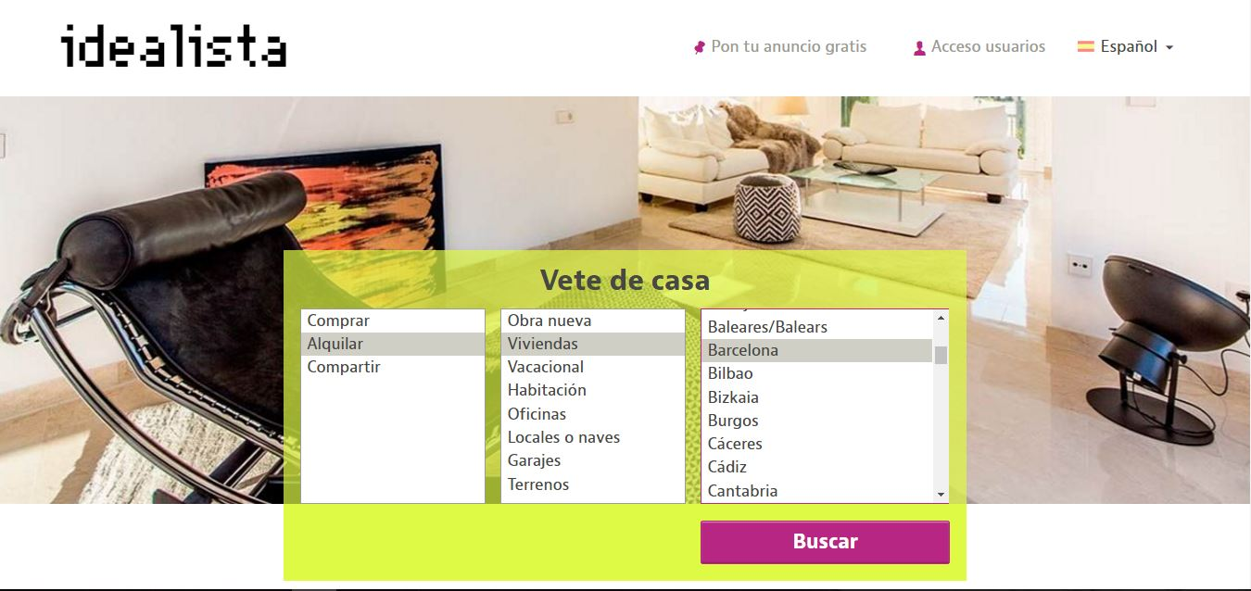
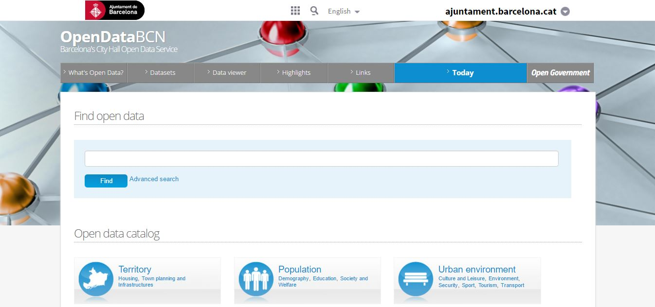
Data Source
Idealista API
http://idealista.com
OpenDataBCN
http://opendata.bcn.cat
Notes:
Idealista API data. Features examples: flat’s size in squared meters, number of rooms and bathrooms, lift, parking, floor, etc. (November 2016)
OpenDataBCN: Average price per neighborhood (October 2016)

Slide 2

Data ETL
JSON
Data Cleaning
CSV
Idealista API
100 req/Mo=5000 flats/Mo
1 req/s
Location centered req
2 credentials
CSV
Postgre DB
CSV
Merging this feature with the properties
OpenDataBCN
Average price per neighborhood
Notes:
Manual ETL. Can be automatize but in the future if we have a less restricted access to Idealista’s API.
Generic data cleaning to load the most complete and valid dataset to the DB: drop non informative features, keep flats where “municipality”=Barcelona, replace string per number in “floor”, convert some feature to numeric, combine some features (“propertyType” and “Typology”), create dummies (“district”)
More specific data cleaning (remove outliers for instance) done just before applying the regression model.

Slide 3
Data Overview
1820€
Average price
Number of flats per neighborhood on a CartoDB heatmap.
(example in next slide).
You need to install this PowerPoint add-on to see it as a live content:
https://www.liveslides.com

Slide 4

Notes:
LiveSlide https://fmicand.carto.com/builder/84125710-4872-11e6-ba69-0ee66e2c9693/embed

